Slide 1
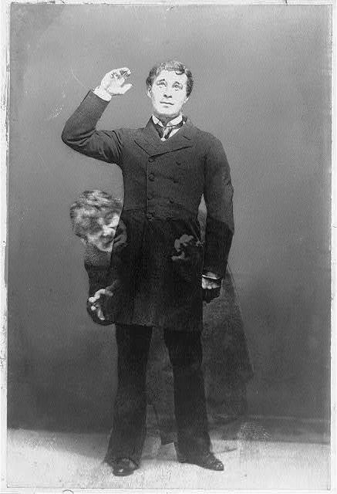
Hyding the Subject?: The Antinomies of Masculinity in the Strange Case of Dr. Jekyll and Mr. Hyde
-Ed Cohen
Joshua Pinedo
Shaquire Dean
Estefani Mora

Slide 2
Article Summary
Ed Cohen‘s article Hyding the Subject?:The Antinomies of Masculinity in The Strange Case of Dr. Jekyll and Mr. Hyde makes light of the perception of men during the Victorian era. Cohen’s focus is on what constitutes a proper male figure during this period, the subjectivity of men, the “doubleness” of human nature and how this characteristic evoked fear into Victorian society.

Slide 3
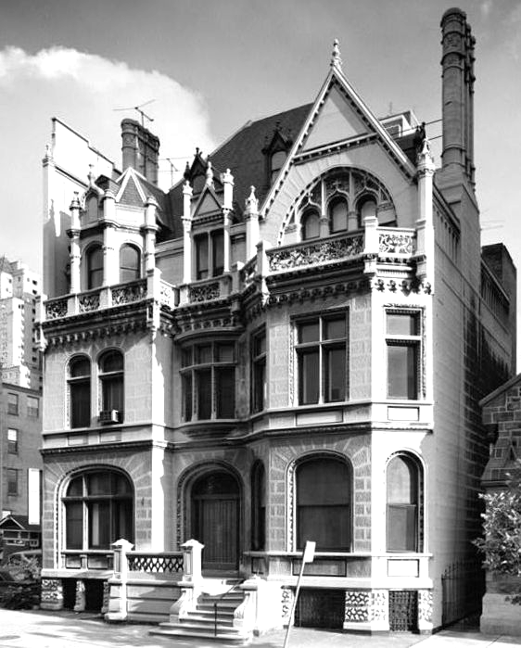

Thesis
“Instead, my concern with the novel will consider the narrative’s doubling of the male body in the “dual person” Jekyll/Hyde as a symptom of the antinomies that destabilize male “character” itself”. (Cohen 181)

Slide 4
Sub-Claim 1
Cohen states, “ ...the narrative turns around an unarticulated opposition between a political and economic assumption that (male) “character” unproblematically represents the embodied attributes of a (male) person and gender ideology that qualifies masculinity as “proper” male character” (Cohen 182).
This relates to the story in that an individual who possesses political or economic wealth such as Jekyll, Lanyon, and Utterson, have achieved the status of Bourgeois men in Victorian society. On the opposing side we have Mr. Hyde who by nature should be considered a “proper” man, but his lowly status in society is based upon his improper thoughts and human desires. This has relegated him to a primitive being who has been stripped of his masculinity. This clearly demonstrates the separation and duality of a man’s identity.
Notes:
This touches on the social status in the Victorian area. A man with impure thoughts, who does not adhere to Victorian standards (Hyde) can not reach the status of Bourgeois men. This implies that many men put up a facade to retain social standing, all the while they are hiding their true nature.

Slide 5

Sub-Claim 2
In the article Cohen states, “Indeed, it hardly comes as a surprise that from the 1880s on, fictional depictions of English masculinity often narrativize the difficulties of the male embodiment as a splitting within the male subject precisely in order to assert new modes of self-representation”. (Cohen 183)
Jekyll states “Inclined by nature to industry, fond of the respect of the wise and good among my fellow-men, thus, as might have been supposed, with every guarantee of an honourable and distinguished future”. (Stevenson 73)
In other words Cohen is trying to imply that the male subject was pictured differently in the 1880s, symbolically the splitting is meant to be as a dual personality, just like Jekyll and Hyde. In the primary source Jekyll states that in those times, it was a given that men like him were given this specific role to follow and to do what society demanded him and others to do.
Notes:
Even though Jekyll and Hyde do have different physical aspects they are both Jekyll. Jekyll can do as much harm as he wants because everyone saw Hyde as a malevolent character.

Slide 6
Sub-Claim 3
The words from Dr. Jekyll concerning his intelligent thoughts indicating one body duality, to contradictory, two unlike characters as well as contrasting persons in a single mind.
Hyde was considered bad in my opinion, this was because of his wildness and violence as well as him having distance curiosity.
We have seen in our society concepts such as athletic play and work, also the gentleman himself is not stable as he shows the surface. This gives room for various definitions of what Ed Cohen is calling “antinomies”.
Stevenson portrays Victorian London by, being attended by purely men and no women invited.
Stephenson romance propelled the struggle between the transgressive and normative embodiment of the 19th century English masculinity thus making intelligible and visible contradictions which permeate configurations which oppose the identity of the male gender (Cohen 182).
Structurally the story turns around the opposition between the male’ characters economic and political assumptions representing males’ embodied attributes and gender ideology (Cohen”Hyding”197)

Slide 7
Sub-Claim 4
Cohen states “Instead, the novel comes to affirm the “earnestness” of “both sides” by portraying a larger failure of “character,” that is, a failure of the coherence attributed to this narratological/sociological representation of personhood itself”. (Cohen 192)
“Between these two, I now felt I had to choose. My two natures had memory in common, but all other faculties were most unequally shared between them”. (Stevenson 84)
The sincereness of “both sides” meaning Jekyll and Hyde, weren’t true to themselves, it was a failure in character due to them being unfaithful to their logical and social representations. In the primary source quote, it is implied that Jekyll “believes” that Mr. Hyde and him are two different persons, but this is not true because Jekyll is as much of Hyde as Hyde is Jekyll.
Notes:
Stating that both Jekyll and Hyde, were not true in their own nature, Hyde wasn’t as evil as he was perceived and Jekyll was not as good as he was.

Slide 8
Opinions
(Estefani) Even though the story is fiction, I understand the whole aspect of the “dual personality” Cohen is trying to explain. He gives many components of the story and also of the Victorian era, that makes you perceive the era as if you were there. As Cohen states that the novel is ubiquitous, because it’s everywhere and very relatable. Cohen states, “Stevenson’s story is ubiquitous both in its fictional forms and it has helped to make sense of the representational problems engendered by “non-fictional” male subjects”. (Cohen 196)
(Joshua) Cohen’s arguments present an in depth description of the masculine ideology in the Victorian Era. Throughout his article Cohen emphasizes the duality of man being attributed to privilege and the lack thereof. As it pertains to The Strange Case of Dr. Jekyll and Mr. Hyde, the story represents in part, the societal division between classes. This is evident in Dr. Jekyll’s propriety and the vilification of Mr. Hyde.
(Shaquire) I believe understanding this will direct the attention of leaders to tenacious focus available in its characters of male genders to show fear of failures of masculinity as a coherent subject position. I consider this novel to achieve the possessive individualism for English masculinity.
Notes:
When saying relatable, I mean that everyone not only men have different sides within them, not like Hyde, but we tend to show different faces to different situations.(EM)

Slide 9
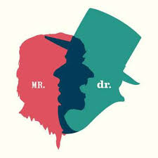
Work Cited
Cohen, Ed. “Hyding the Subject?: The Antinomies of Masculinity in the Strange Case of Dr. Jekyll and Mr. Hyde.” JSTOR, 2004, www.jstor.org/stable/30038535.

